Slide 1
Why should people care gender bias in NLP
Giuseppe Serna

Slide 2

Natural Language Processing in AI
Question Answering
Machine Translation
Speech Recognition
Document Summarization
Text Classification
Language Modeling
Notes:
The acronym NLP means Natural Language Processing, a branch of artificial intelligence that deals with the interaction between computers and humans (natural) language. Applications of Natural Language Processing are every day more pervasive due to the tasks they solve. in a few years they have changed our perception of the world and the way we interact with computers.

Slide 3
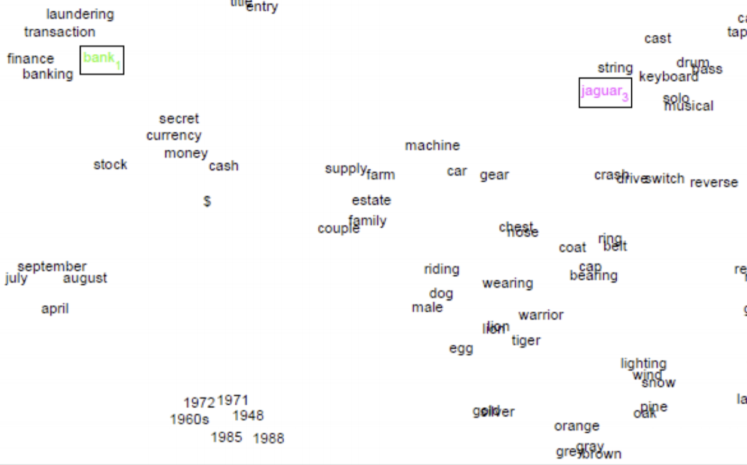
What word embeddings are and what they look like
words as vector
capture semantic
capture syntax
similar words close
Notes:
In order to understand better some mechanisms, I’m showing how words are represented in NLP. Word embeddings are a way to map words as vectors in a vector space where distance between words represent the semantic similarity.

Slide 4
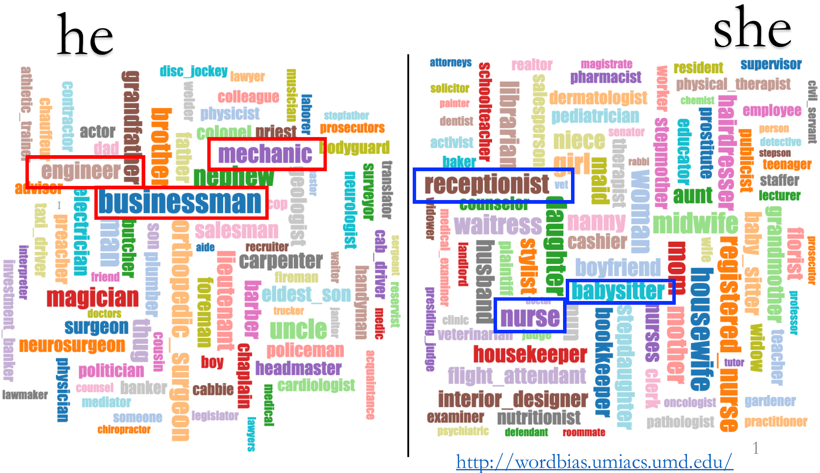
Words about professions in word embeddings
Notes:
Word embeddings are created using a large amount of data from the web this can suggest that they are highly morally charged, here we can see that they encode societal biases about gender roles and occupations, e.g. engineers are stereotypically men, and nurses are stereotypically women. As a consequence, applications that use these word embeddings also reflect this bias.

Slide 5
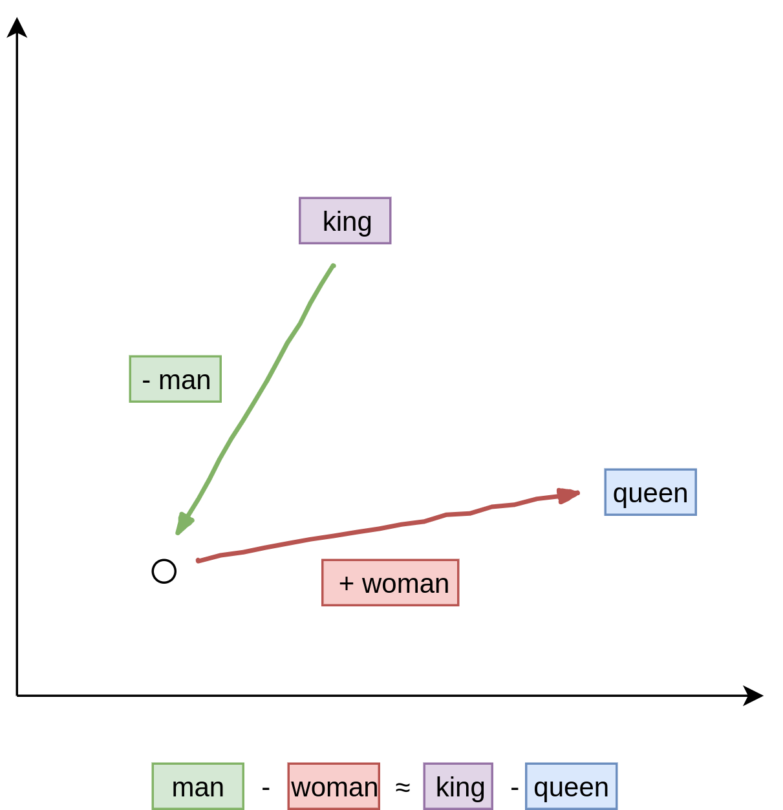
Word vect and algebra operations
man is to king as woman is to queen
Notes:
one of the more important feature of word embeddings is that a simple algebra operation as subtraction allow to solve analogy problem in this example we want to solve the problem man is to king as woman is to ? , that can be solve taking king less man plus woman that give queen as best result. this It’s a very powerful tool. Indeed is studied and used in a variety of applications.

Slide 6
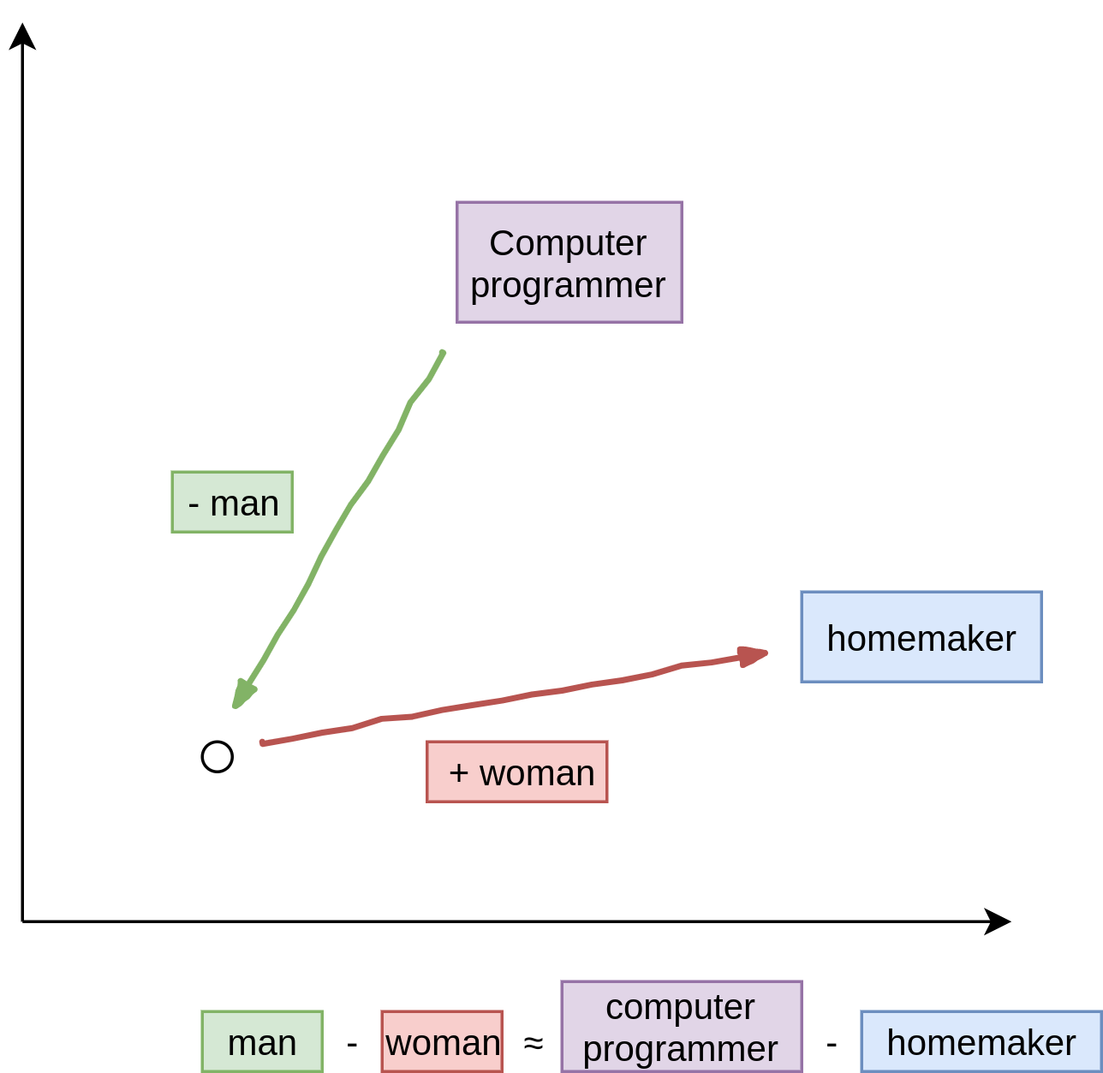
Word vect and gender bias
man is to computer programmer as woman is to homemaker
Man is to Computer Programmer as Woman is to Homemaker? Tolga Bolukbasi Kai-Wei Chang
Notes:
However In 2016 a paper shows that results like these are also present in word embeddings. do you think that homemaker can be the best response for the analogy man is to computer programmer as woman is to ? think about that

Slide 7
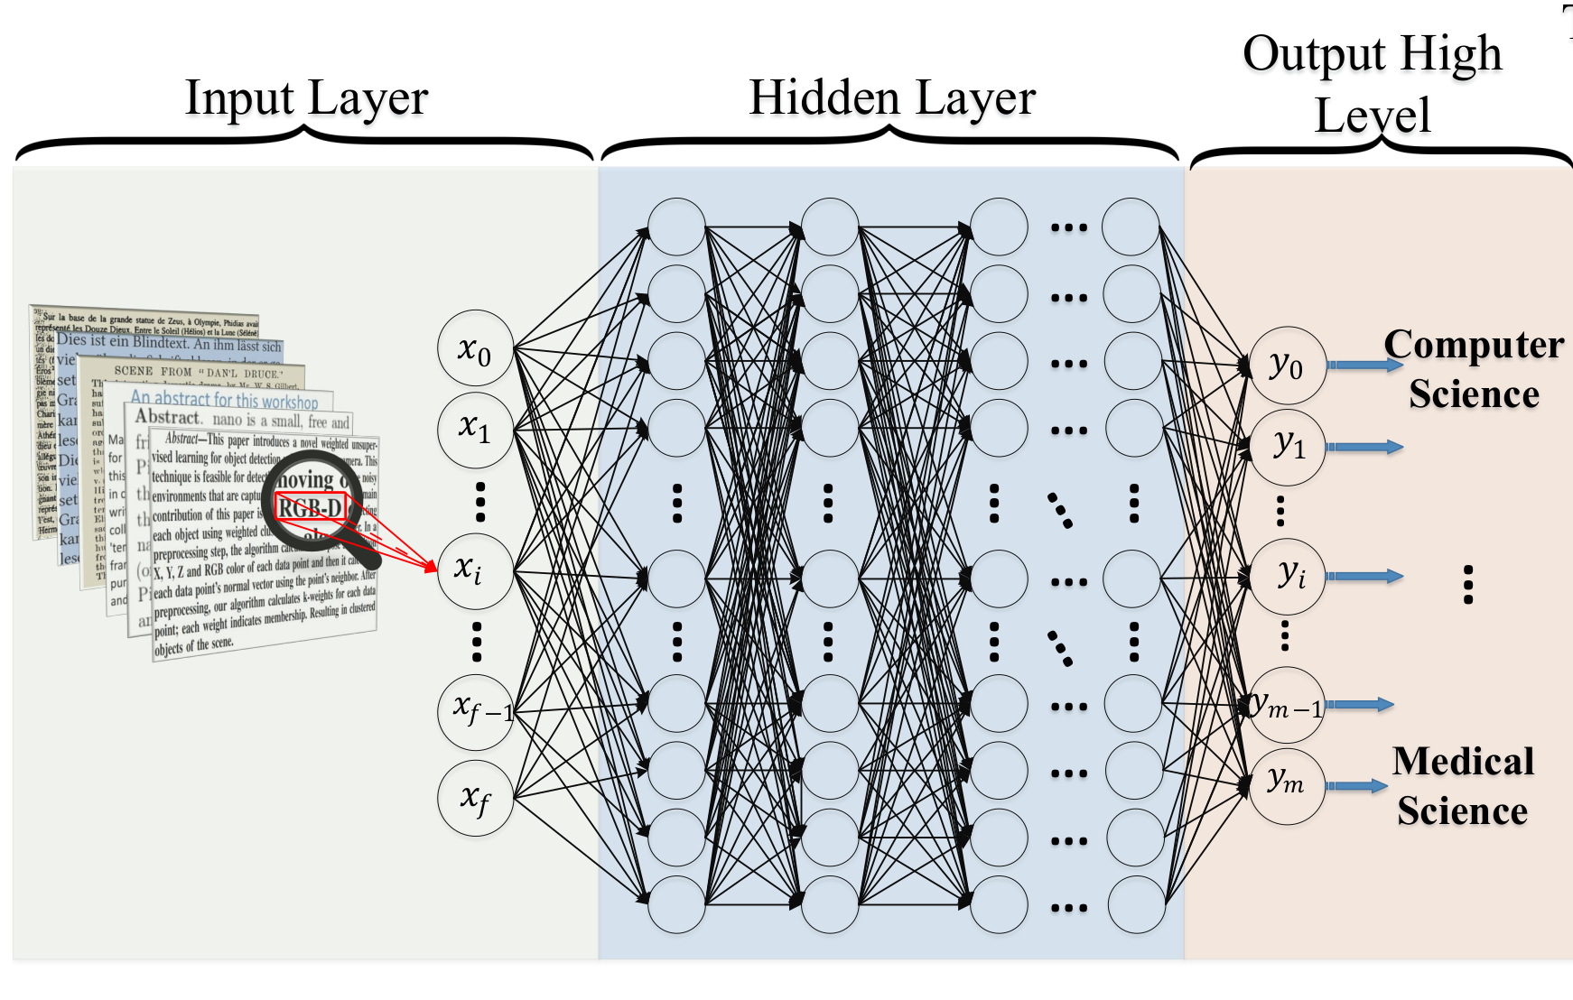
Word vect are inputs for Deep Learning models
Best Performance
Minor Interpretability
Notes:
And think that in NLP word vectors are input for DL model that are famous for have the best accuracy but also to work more or less as black box model, because in the end is not easy to see which correlation are used in, given all these premises, can you imagine what can happen?

Slide 8
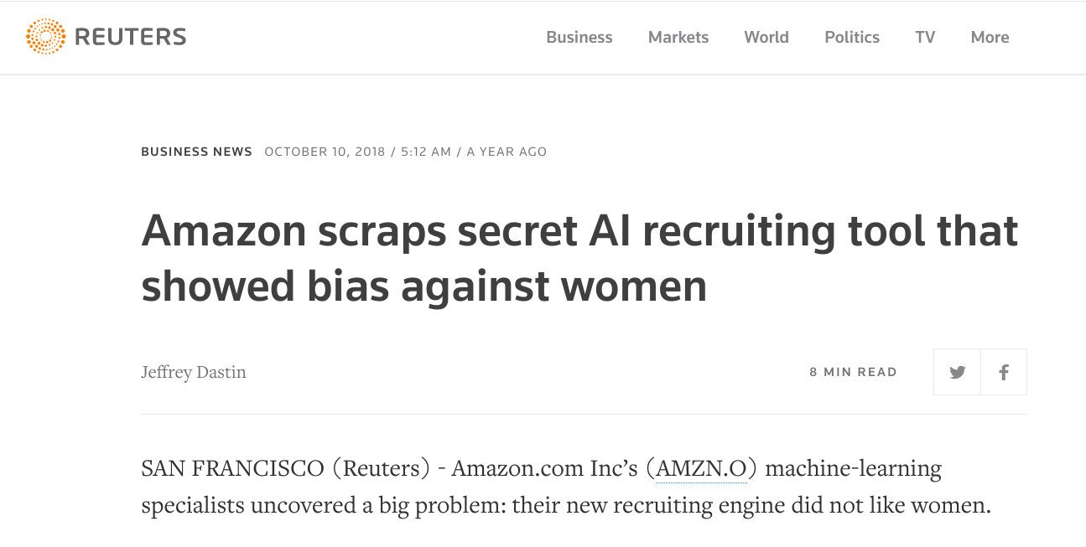
This can unintentionally lead to
Bias Propagation
Notes:
Due to the large usage as basic features, word embeddings not only reflect such stereotypes but can also amplify them, in this case, amazon realized bias amplification effects only after the social consequences took place .in this case this tool have recruited only men for the whole time it's worked. This poses a significant risk and a complex challenge for NLP and its applications.

Slide 9

Who leads NLP research?
Few groups of people
Trust Issue
Responsibility Issue
Notes:
But is it right that this challenge and its risks are responsibility only of its developers? Is clear that NLP ethics should take more seriously the moral charge of its applications , however...

Slide 10
We are all NLP users
Users who use the technology may formulate certain wishes or requirements for the functioning of a technology
Regulators (organizations) can formulate rules or regulations that engineering products have to meet (e.g concerning discriminations)
Notes:
NLP engineers are not the only ones who are responsible for the development and consequences of technology. As users we have a role in the direction that NLP development will take in the future.

Slide 11
Gender Bias in NLP
Now :
Complex problem
No one-time fix exist
Have social consequences
In the Future:
More pervasive AI
more complex ML models
More critical decision
Notes:
that’s why it is important to have an active responsibility approach, formulating not only functional requirements but also ethical requirements as user in order to avoid now bigger problems that may happen in the future and in order to try to mitigate bias in the real world. beacuse today gender bias is…..and tomorrow can be worse.

Slide 12
Conclusions
NLP is pervasive
Influences our perception of the world
Particularly charged of morality
Amplify morality
Designed by an elite of people
But is not just an engineering problem
User responsibility is needed
Notes:
What I argue until now is that, NLP is pervasive and have a strong influence in our perception of the world, it’s particular morally charged and can easily amplify morality. Even if it’s developed by a particular class of AI engineers, its social consequences are not only an engineering problem.
Users have an important role and have to be conscious of that.

Slide 13
Thank you for your attention

